Slide 1
CS499 - Open Source software development
Lecture #02: Basics about open source software
Dr. Igor Steinmacher
e-mail: igorfs@utfpr.edu.br
Twitter: @igorsteinmacher

Slide 2
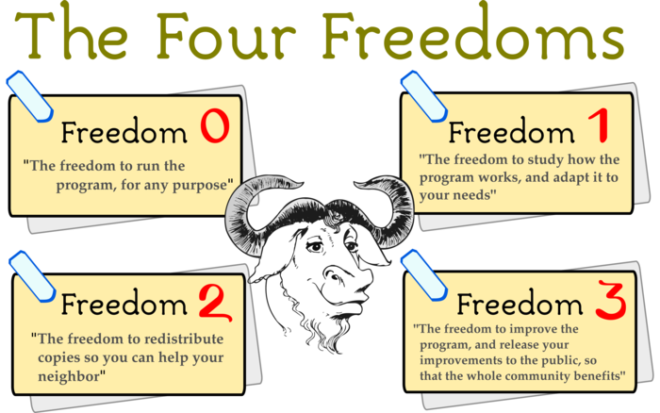
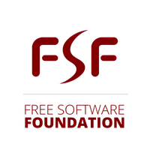

Slide 3

OSD Criteria
1. Free Redistribution
2. Source Code
3. Derived Works
4. Integrity of The Author's Source Code
5. No Discrimination Against Persons or Groups
6. No Discrimination Against Fields of Endeavor
7. Distribution of License
8. License Must Not Be Specific to a Product
9. License Must Not Restrict Other Software
10. License Must Be Technology-Neutral
https://opensource.org/osd
Notes:
c

Slide 4

Questions
What is Open Source about?
Price?
Notes:
c

Slide 5
Questions
What is Open Source about?
Price?
License?
Notes:
c

Slide 6
Questions
What is Open Source about?
Price?
License?
Social Movement?
Notes:
c

Slide 7
Questions
What is Open Source about?
Price?
License?
Social Movement?
Hobby?
Notes:
c

Slide 8
Questions
What is Open Source about?
Price?
License?
Social Movement?
Hobby?
Market trend?
Notes:
c

Slide 9
More Questions
Software vs. hardware: what’s the difference?
Engineering vs. Software Engineering
Tool vs. Knowledge
Product vs. Service

Slide 10

So…
Open Source is about…
Freedom
License
Code as a way to share knowledge
Community!

Slide 11

A little bit of history

Slide 12
Pre-historic…
Commercial settings:
software is usually part of a bigger solution (consulting, hardware, maintenance, etc.)
not a solution per se
Academic settings:
Software is informally shared as a way to share knowledge
Hobbyists
Hacking for fun
Garage programmers community

Slide 13
And the History…
1976 – Bill Gates’ “Open Letter to Hobbyists”
Copyright infringement + commercial power
“Will quality software be written for the hobby market?”
“One thing you do do is prevent good software from being written.”
1980 – Stallman problem with Xerox printer
Stallman refused access to the source code for the printer driver
1981 – IBM signs a deal with “Micro-Soft”
MS-DOS embedded in each and every IBM machine
1984 – Stallman launches GNU project
1985 – Free Software Foundation (FSF) was formed to house funding for the GNU Project

Slide 14
And the History…
1991 – Linus Torvalds creates (or kicks off) Linux
Personal/informal project
Message to a newsgroup at Usenet
V 1.0.0 released in 1994 with 170+ KLoC
1995 – Internet Boom
Linux is distributed in large-scale
1997 – Eric Raymond writes “The Cathedral and the Bazaar”
Advantages of Open Source
Development in a decentralized way

Slide 15
And the History…
1998 – Netscape open-sourced
Fight with MS Explorer?
1998 – Eric Raymond, Linus Torvalds and others launch the Open Source Initiative (OSI)
Technical reasons to Open-source
Use of “Open Source” instead of “Free software”
1999 – Sourceforge is launched
2000 – OpenOffice is launched
2001 – IBM invests $1 billion on Linux

Slide 16
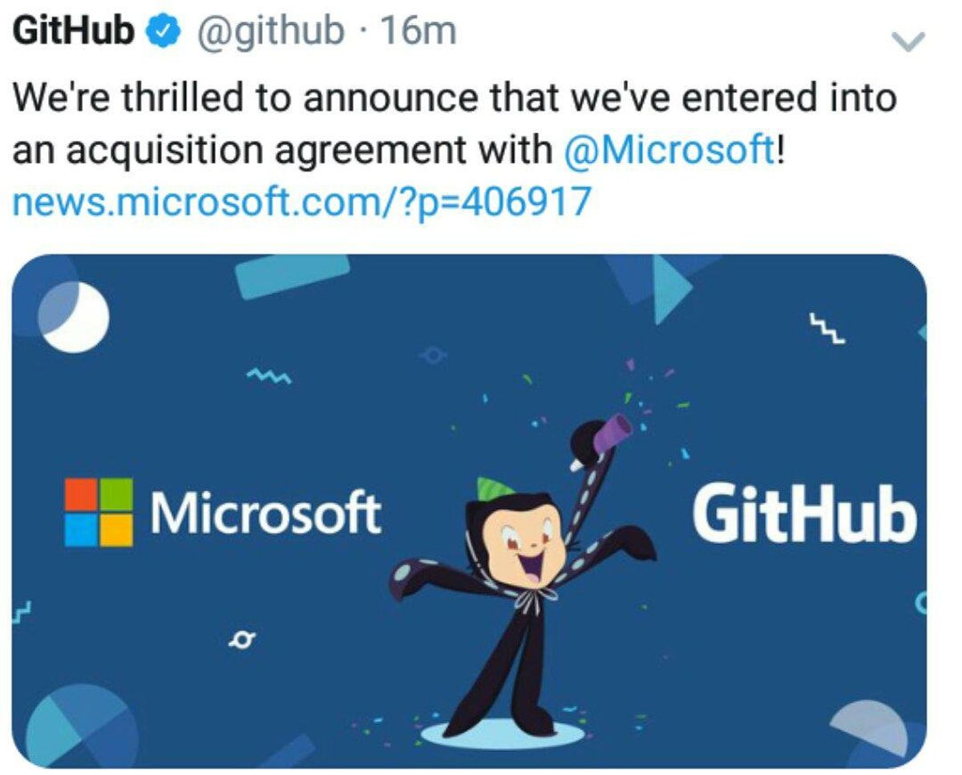
And the History…
2005 – Sun launches Solaris 10 as Open Source
2007 – Sun launches JDK under GPL
GitHub launches in 2008
GitHub BOOM ~2010–2011 (2 million repos in 2011)
… MANY COMPANIES JOINING

Slide 17
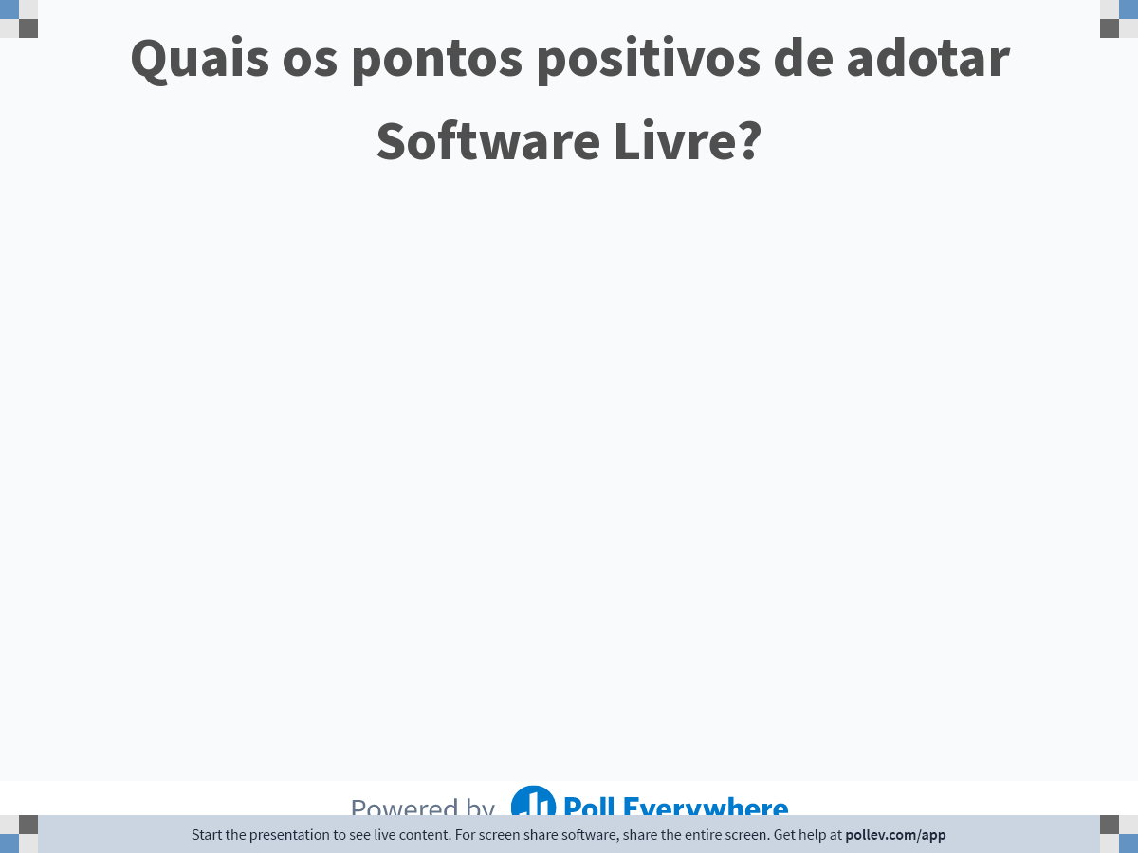
Notes:
Do not modify the notes in this section to avoid tampering with the Poll Everywhere activity. More info at polleverywhere.com/support Quais os pontos positivos de adotar Software Livre?
https://www.polleverywhere.com/free_text_polls/Th22TV2vYeEEnezWwr29n

Slide 18
Why OSS???

Slide 19
Why Open Source?
Incentive to collaboration → human relationship
Technical education
“Low-cost” access to “high-end” technology
Decentralizes the “power” of the software
Government → knowledge and transparency

Slide 20
Why Open Source?
Less cost (is that a thing? When?)
Less bugs → More quality
“Given enough eye-balls all bugs are shallow”
Customization and improvements
Competition for support

Slide 21
“Problems”
Quality assessment of the solutions
Reputation (FUD)
Sustainability
“Intellectual property”

Slide 22
Final facts

Slide 23
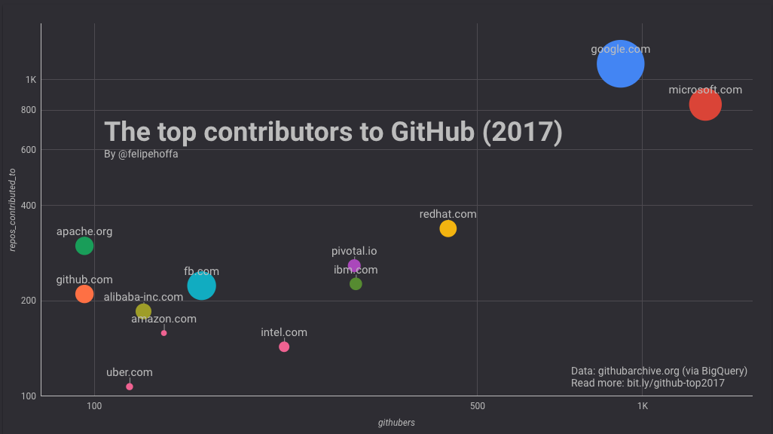
And… Open source leads the way

Slide 24
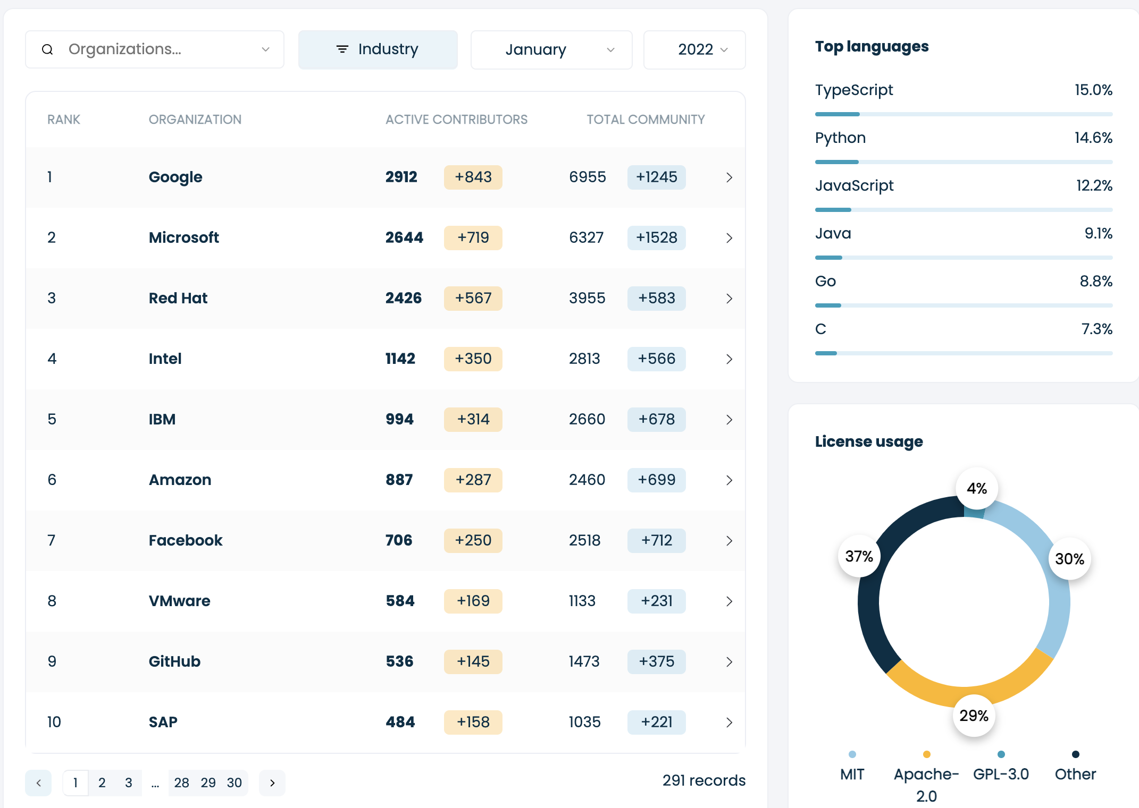
And… Open source leads the way
https://opensourceindex.io/

Slide 25

Why are companies Open-sourcing?

Slide 26

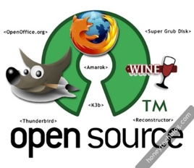

Leveraging the Crowd
“The World Wide Web became a tool for bringing together the small contributions of millions of people and making them matter”
Collaboration in large-scale

Slide 27
Pinto, Steinmacher, Dias and Gerosa, On the Challenges of Open-Sourcing Proprietary Software Projects, Empirical Software Engineering, 2018

Slide 28

All About Community!
OpenStack:
12.9M lines of code
37 programming languages (mainly Python)
11.6K+ code contributors
Mozilla Firefox:
24.5M lines of code
48 programming languages
8.5K+ contributors (1K+ in the last 12 months)
Swift:
800K lines of code
1K+ contributors
https://www.openhub.net/p/openstack
https://www.openhub.net/p/firefox
https://www.openhub.net/p/apple_swift

Slide 29
Assignment!
TRABALHO EM GRUPO
Prazo: 14/03/2022 (Segunda) antes da aula
Como submeter: Enviar um email para igorfs@utfpr.edu.br, com assunto "SL2022: Tarefa 1"
Buscar referências sobre modelos de negócio e meios de ganhar dinheiro com software livre
Produzir um documento que apresente diferentes maneiras de criar negócios que se baseiem em software livre. Ressaltar os pontos importantes relativos a cada uma das maneiras encontradas e citar exemplos.
Escolher um dos modelos de negócio e analisar com mais profundidade. Pensar em como seria possível que vocês criassem uma empresa em torno disso. Pense no público alvo, nos tipos de serviços oferecidos, nos desafios e nos benefícios que tal empresa pode ter.

Slide 30
For my dear PPGCC students
Cada aluno deverá apresentar DOIS seminários de pesquisa, discutindo artigos científicos dentro da área de comunidades de software livre (gestão de comunidades, licenças, criação, manutenção, entrada de pessoas, diversidade, etc.)
As apresentações estão agendadas para 04/04/2022 e 06/06/2022
Os alunos devem escrever uma resenha de cada artigo e enviar como parte do trabalho
As apresentações devem ter entre 10 e 12 minutos

